Slide 1
Exploring the Dynamics of College Basketball
Joseph Halloran, Adam Slivinsky, Henry Waterhouse

Slide 2
Our Data
Our data comes from Kaggle’s March Madness Machine Learning Dataset
Our main data set consists of regular season college basketball box score data from games during the 2003 - 2023 seasons.
There are 107,634 game entries (rows)
For each of these games, there are 34 features (columns):
There are box score stats for both the winning and losing teams, as well as Season, Game Number, and other non-box score stats.
For example, stats are Score, Field Goals Made (FGM), Field Goals Attempted (FGA), Personal Fouls (PF), etc.

Slide 3
Modifying the Data
To quantify team performance in a single season, we went through the game data and collected the season average box score stats for each team and their opponents.
We take the ratio of the two to form the Ratio of Average Team Stat (RATStat) for each box score statistic:
RATScore_{i,j} = (Average Team Score)_{i,j}
(Average Opponent Score)_{i,j}
For each team in each season, we now have 14 features:
RATScore_{i,j}, RATFGM_{i,j}, RATFGA_{i,j}, … RATBlk_{i,j}, RATPF_{i,j}
i = 2003, …, 2023 (Season ID)
j = 1, …, ~350 (Team ID)

Slide 4
Project Goals
The main goal of our project is to implement various Machine Learning algorithms towards finding the relationship between team performance and team summary statistics.
We want to find:
What statistics separate winning from losing teams.
Outliers in data that is very centralized.
The dynamics of how the importance of different statistics changes over the seasons.

Slide 5
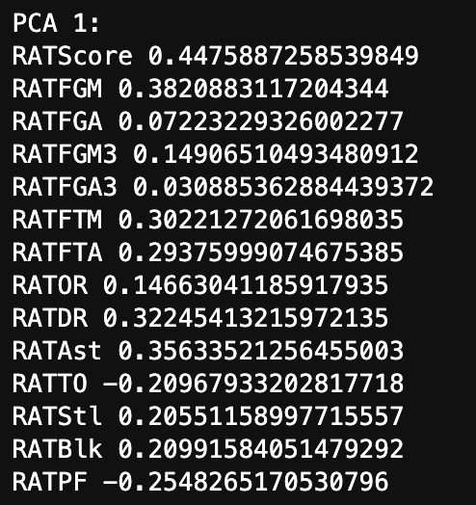
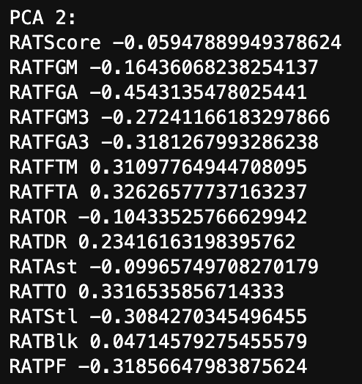
PCA On Ratio Stats (Loadings):

Slide 6
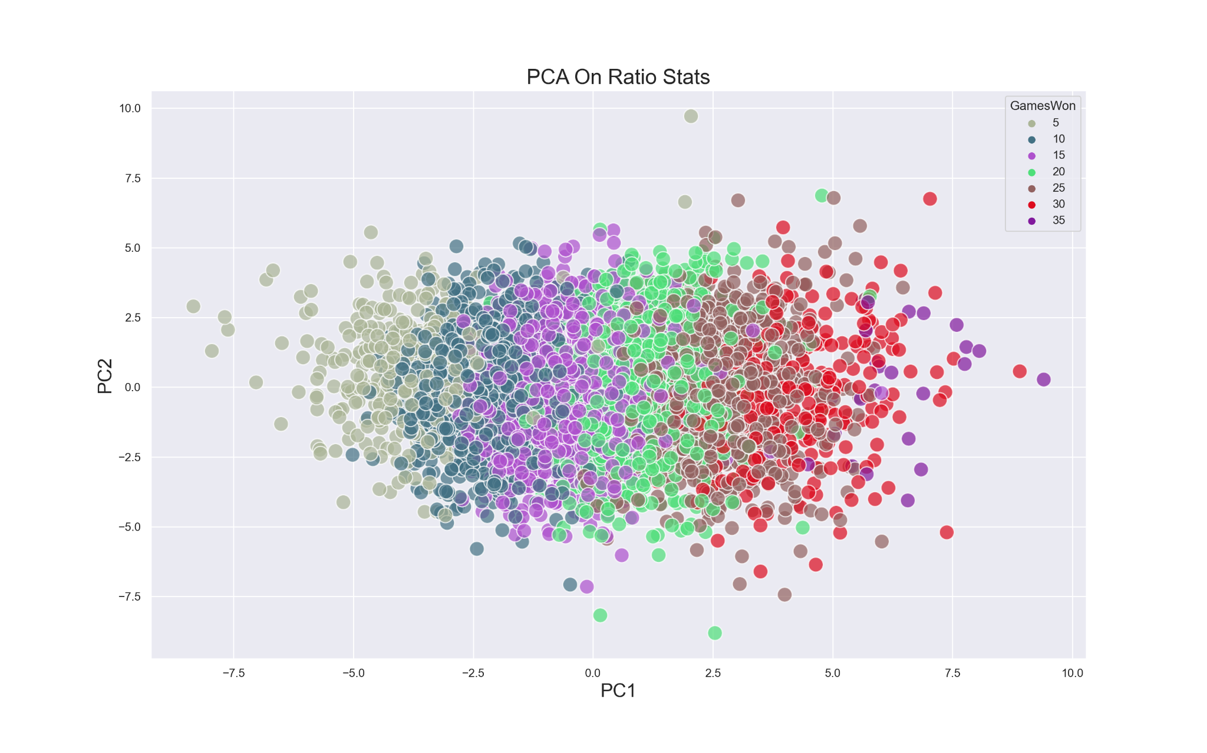

Slide 7
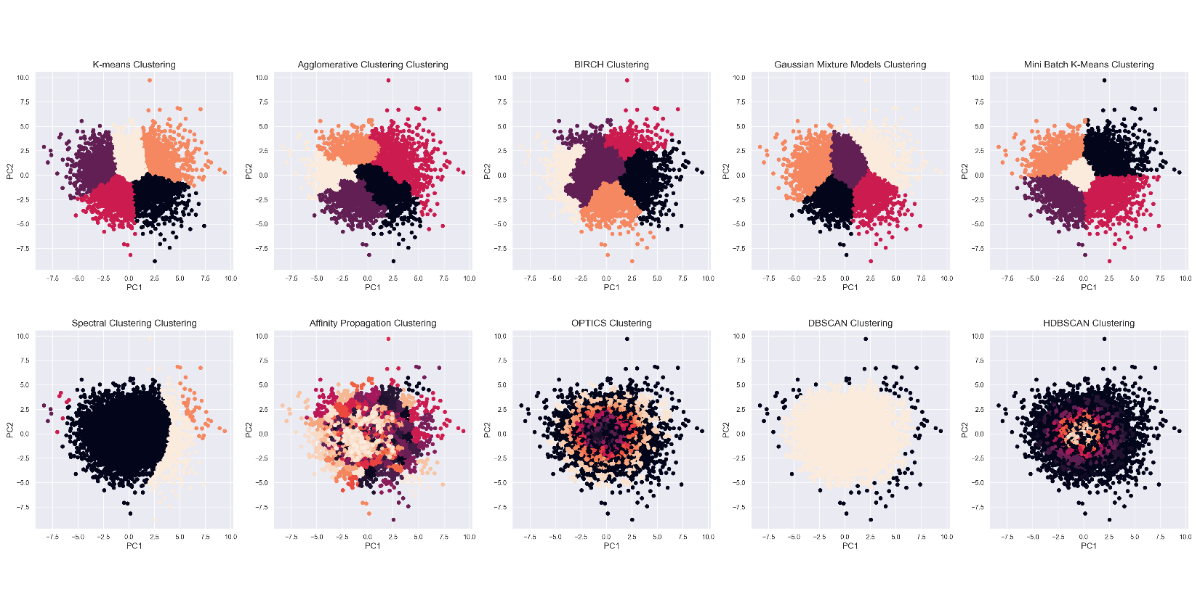
Trying Out Different Clustering Algorithms On Our PCA Data:

Slide 8
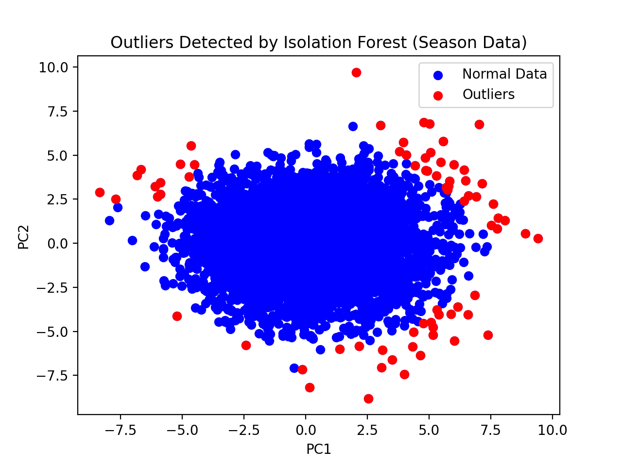
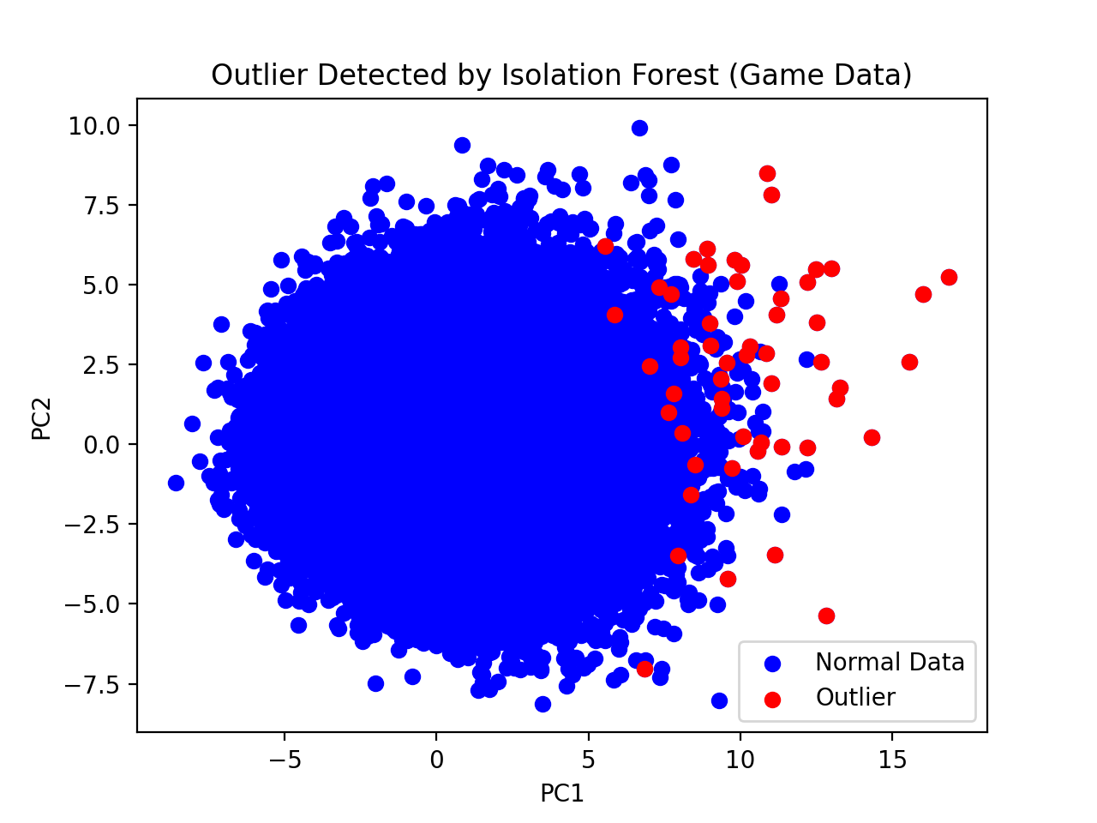
Outlier Detection With High Contamination Value:

Slide 9
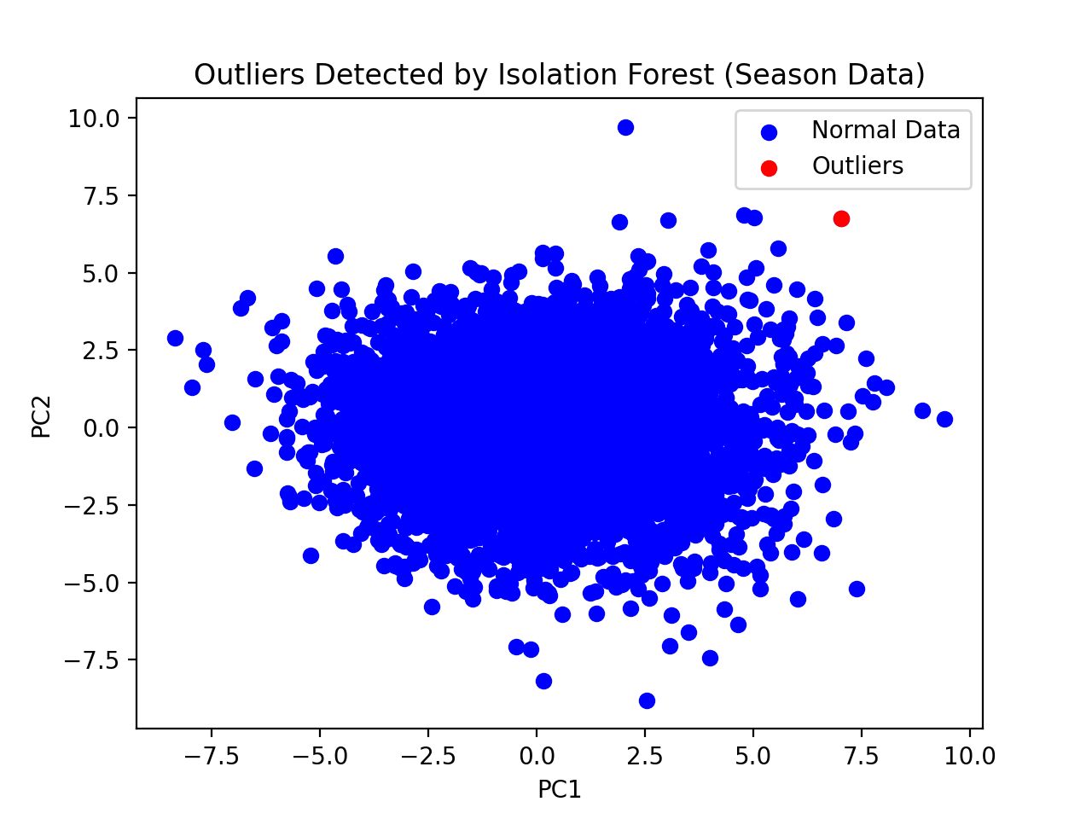
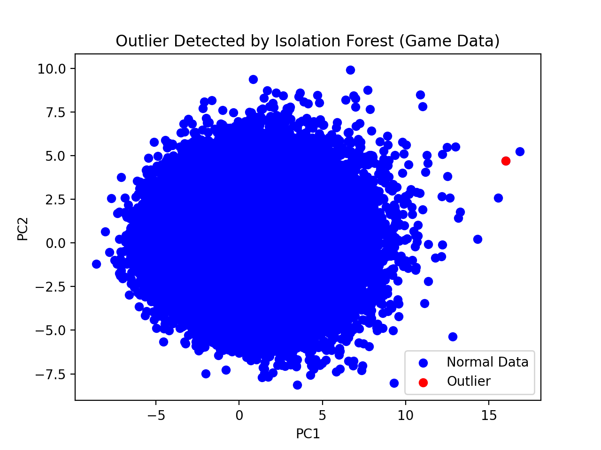
Outlier Detection With Low Contamination Value:

Slide 10
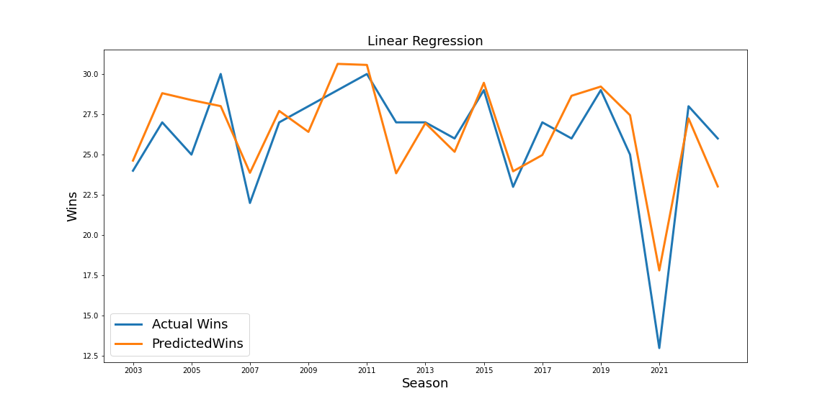
Duke Win Predictions (Scoring Components)
Regression on all RATStats for all seasons combined
Output is number of games won in a season.

Slide 11
How do the RATStats contribute to winning basketball?
For each individual season, we employ various linear regression methods on three different models to explore how the different covariates (RATStats) contribute towards the season outcome of a team, the number of games won
We explore three different models with different combinations of features and feature selection methods:
1. All Features Included
→ Best 14-Feature Model
2. Exclude Score, perform Feature Selection
→ Best 3-Feature Model without Score
3. Exclude Score and Makes, perform Feature Selection
→ Best 2-Feature Model without Score and Makes
For each model, we run scikit-learn’s linear_model package with:
LinearRegression, LassoCV, RidgeCV, and ElasticNetCV

Slide 12
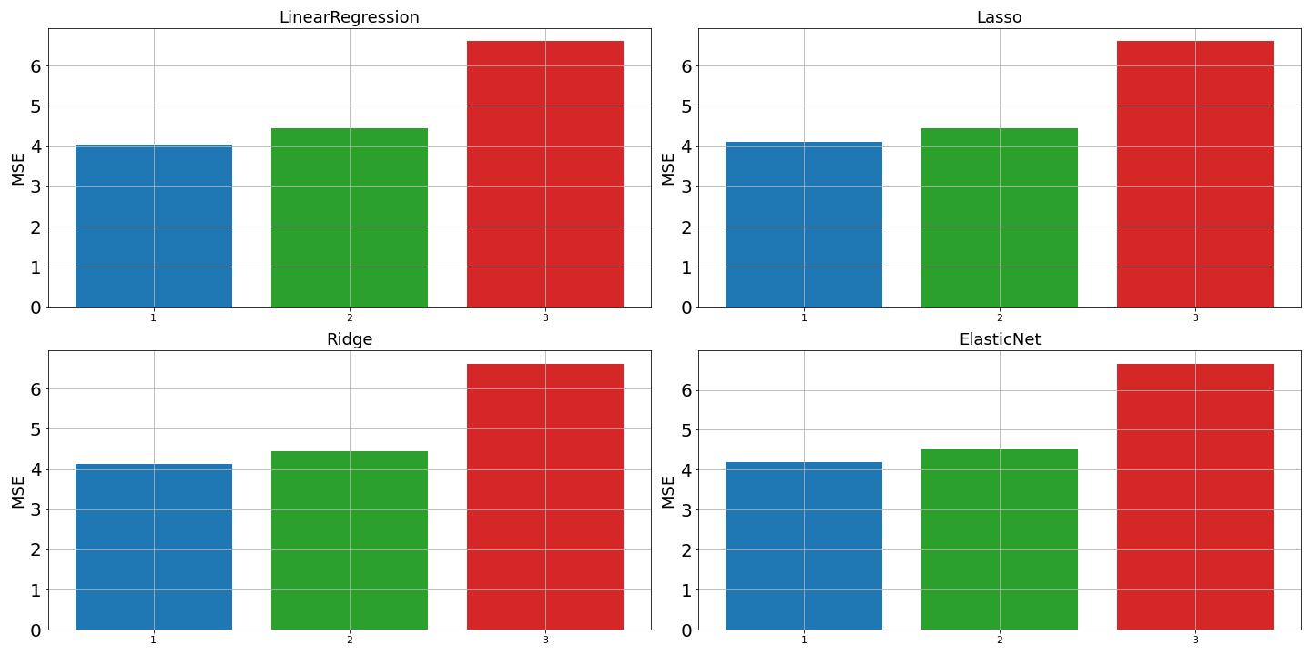
MSE of All Explored Models
Blue = Best 14-Feature Model (all Features)
Green = Best 3-Feature Model without Score:
Red = Best 2-Feature Model without Score and Makes:
MSE is averaged over all 21 seasons

Slide 13
How do the RATStats contribute to winning basketball?
We run each of the three models, (1, 2, 3), on all team RatStats for each individual season and find the proportion that each covariate coefficient contributes to the regression output.
For example, the proportion of the regression output for season i, model m that is explained by RATScore is:
Prop(RATScore)_{i,m} = abs( Regression Coefficient of RATScore )_{i,m}
(sum of all abs( Regression Coefficients ))_{i,m}
We scale the coefficients so the sum of the absolute value of all of the regression coefficients is equal to one , which makes the proportions percentages.
We then create a stacked area plot of each coefficient’s percentages for each model over each of the 21 seasons to show the dynamics of the importance of different statistics.
i = 2003, …, 2023
m = 1, 2, 3

Slide 14
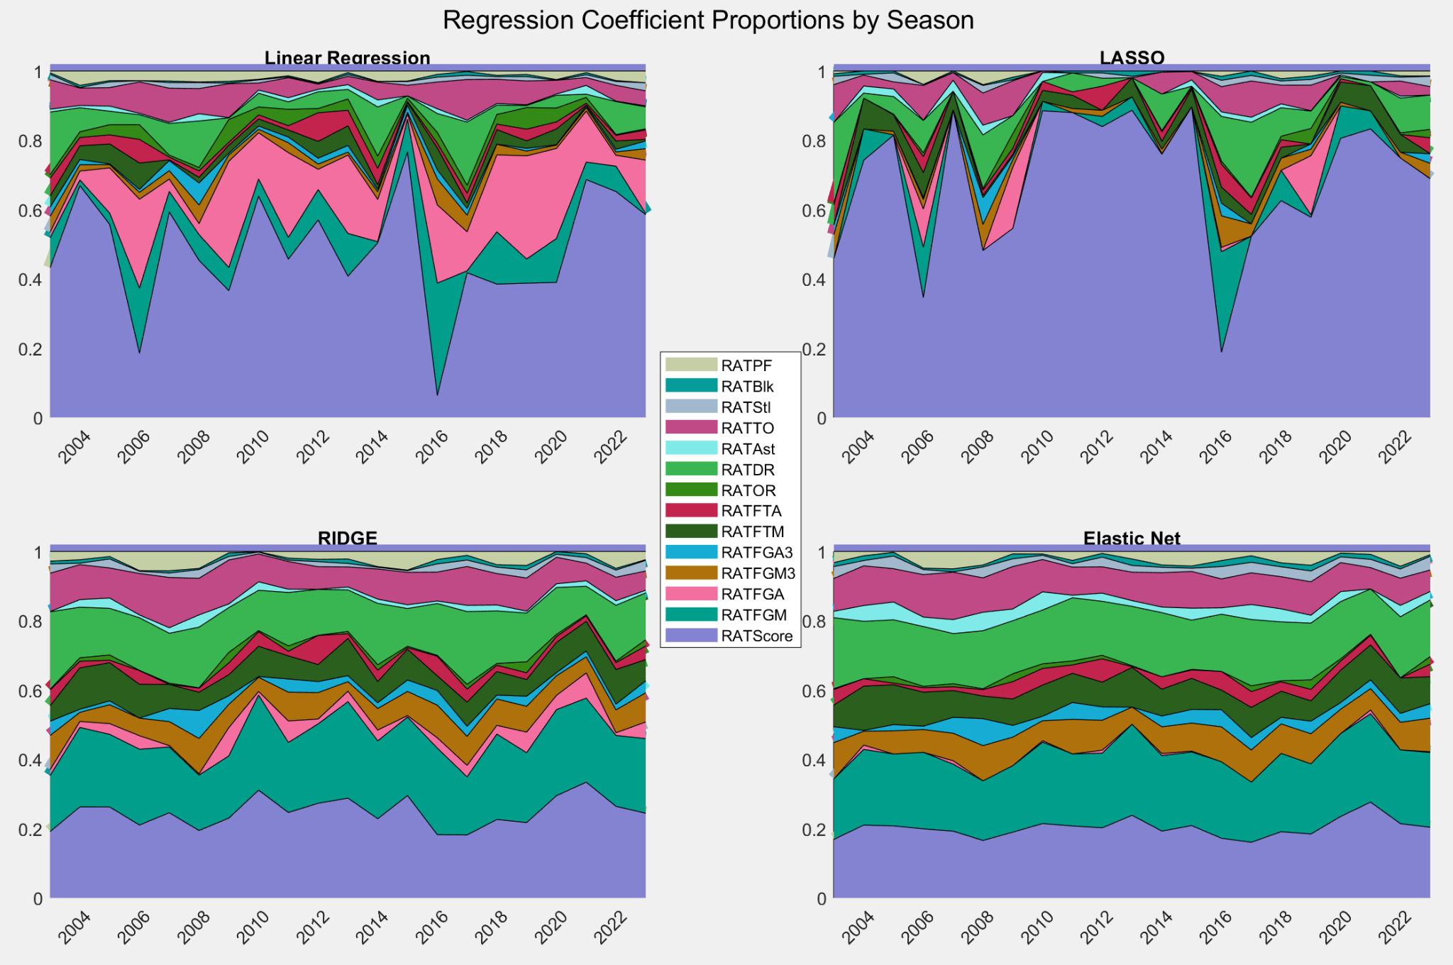
Coefficient Proportions from Regression on Selected Features
1. All Features Included
→ Best 14-Feature Model
Area covered by a color = percentage that feature contributes towards regression output (Games Won/Season)

Slide 15
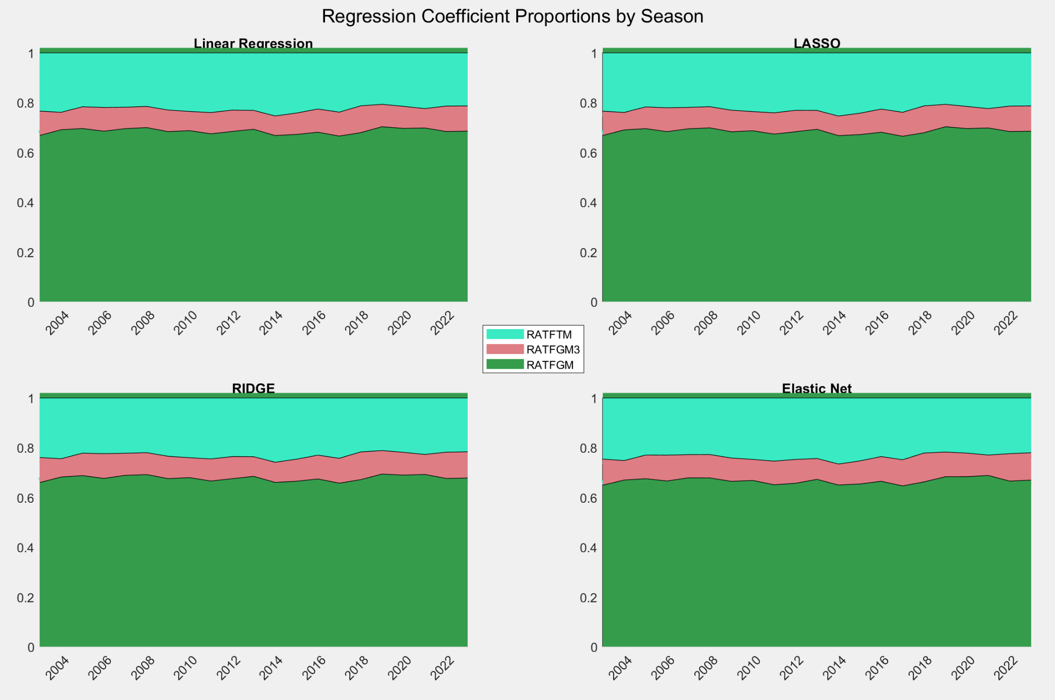
Coefficient Proportions from Regression on Selected Features
2. Exclude Score, perform Feature Selection
→ Best 3-Feature Model without Score
Area covered by a color = percentage that feature contributes towards regression output (Games Won/Season)

Slide 16
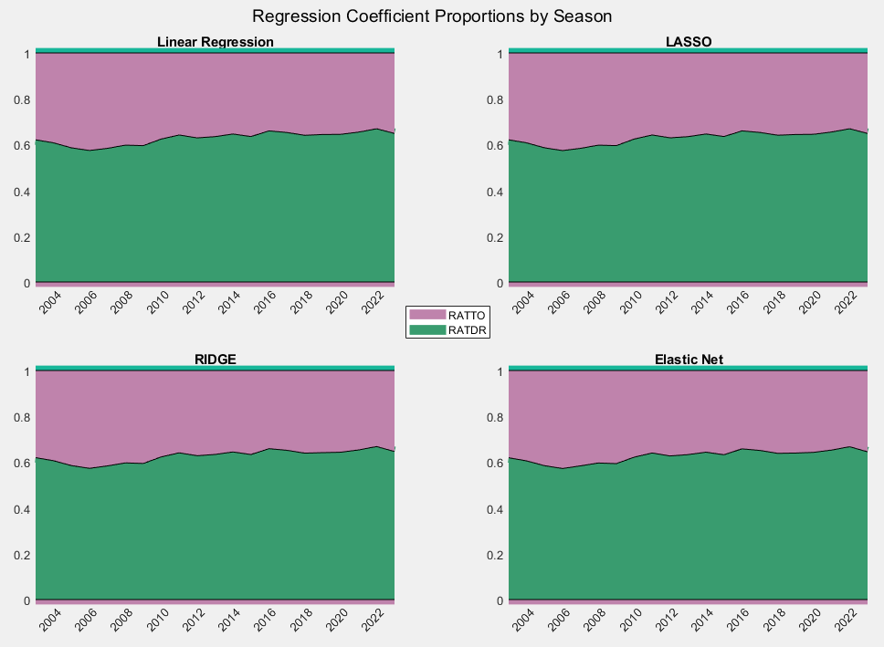
Coefficient Proportions from Regression on Selected Features
3. Exclude Score and Makes, perform Feature Selection
→ Best
2-Feature
Model
without
Score and
Makes
Area covered by a color = percentage that feature contributes towards regression output (Games Won/Season)

Slide 17
MSE of All Explored Models
Blue = Best 14-Feature Model (all Features)
Green = Best 3-Feature Model without Score:
RATFGM, RATFGM3, RATFTM
Red = Best 2-Feature Model without Score and Makes:
RATDR, RATTO
MSE is averaged over all 21 seasons

Slide 18
Project Conclusions
We found that PCA performed well in explaining variance between end-of-season team performance
We developed a few different optimal regression models (1, 2, 3) , to measure the dynamics of the importance of box score statistics
We found that the dynamics stayed relatively constant over the last 21 years

